Slide 1

463 Project: Police Arrival Prediction
By: Sam Axler

Slide 2
Introduction and Importance
When a call is made to the police, there are a variety of factors that decide the urgency of their arrival.
This project was made both as a way to predict police arrival time for potential future cases, as well as locate and identify those important factors and processes that go into their arrival.
Understanding how the police operate is essential to understanding how they handle situations, including situations you may find yourself in the future.

Slide 3
The Categories
These are the categrories I chose to focus on when predicting Police Arrival times:
Contact Type: [Phone or Email]
Impact [The reach of the crime/incident.]
Urgency [How life-threatening the crime/incident is.]
Time of Call [00:00 to 23:59 in Military Time.]

Slide 4
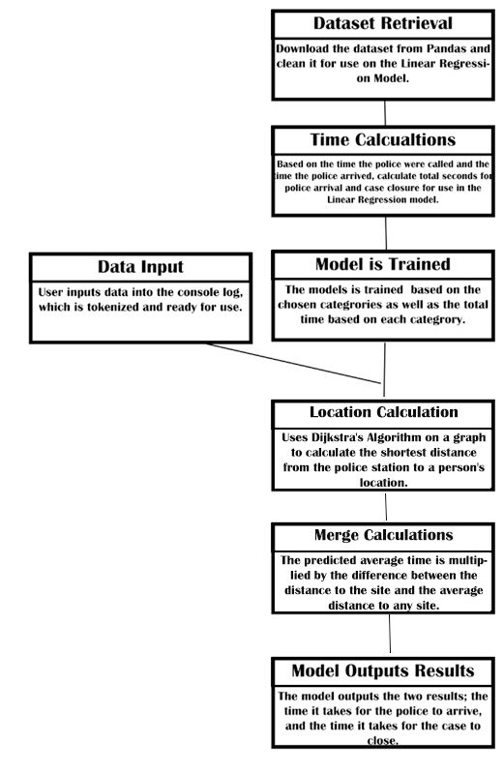
Implementation
Uses a Linear Regression model to try to predict the time it takes for police to arrive.
Time is converted from start-end dates into seconds between the two dates. This gives us a number for the regression model to predict and train off of.
Dijkstra’s Algorithm is implemented, as well as a graph that simulated the distances between city blocks. The police station is displayed as vertex ‘police’, while the other locations are labeled a through f.
The program takes inputs from the user inside the output terminal.

Slide 5
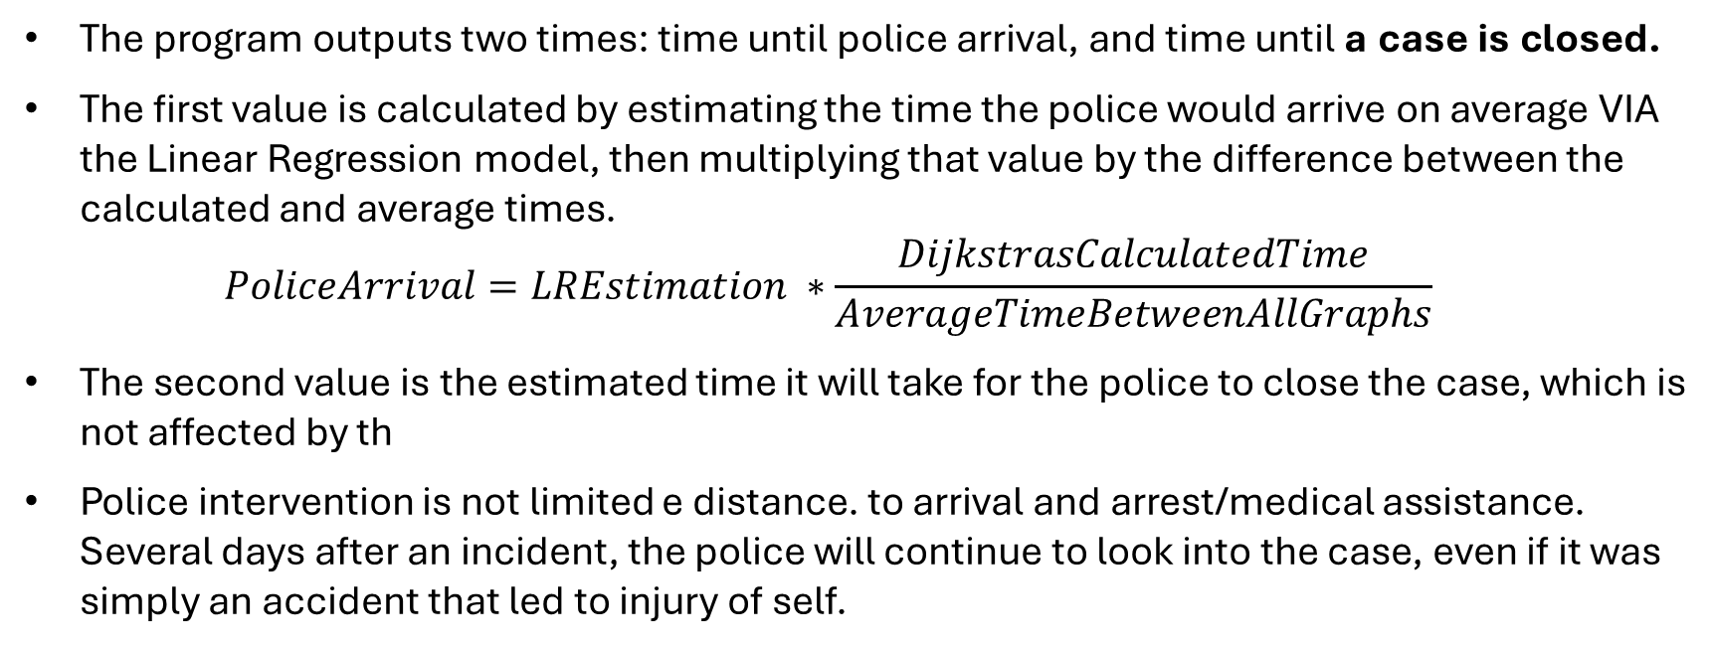
The Output
The program outputs two times: time until police arrival, and time until a case is closed.
The first value is calculated by estimating the time the police would arrive on average VIA the Linear Regression model, then multiplying that value by the difference between the calculated and average times. $PoliceArrival=LREstimation ∗\frac{DijkstrasCalculatedTime}{AverageTimeBetweenAllGraphs}$
The second value is the estimated time it will take for the police to close the case, which is not affected by th
Police intervention is not limited e distance. to arrival and arrest/medical assistance. Several days after an incident, the police will continue to look into the case, even if it was simply an accident that led to injury of self.

Slide 6
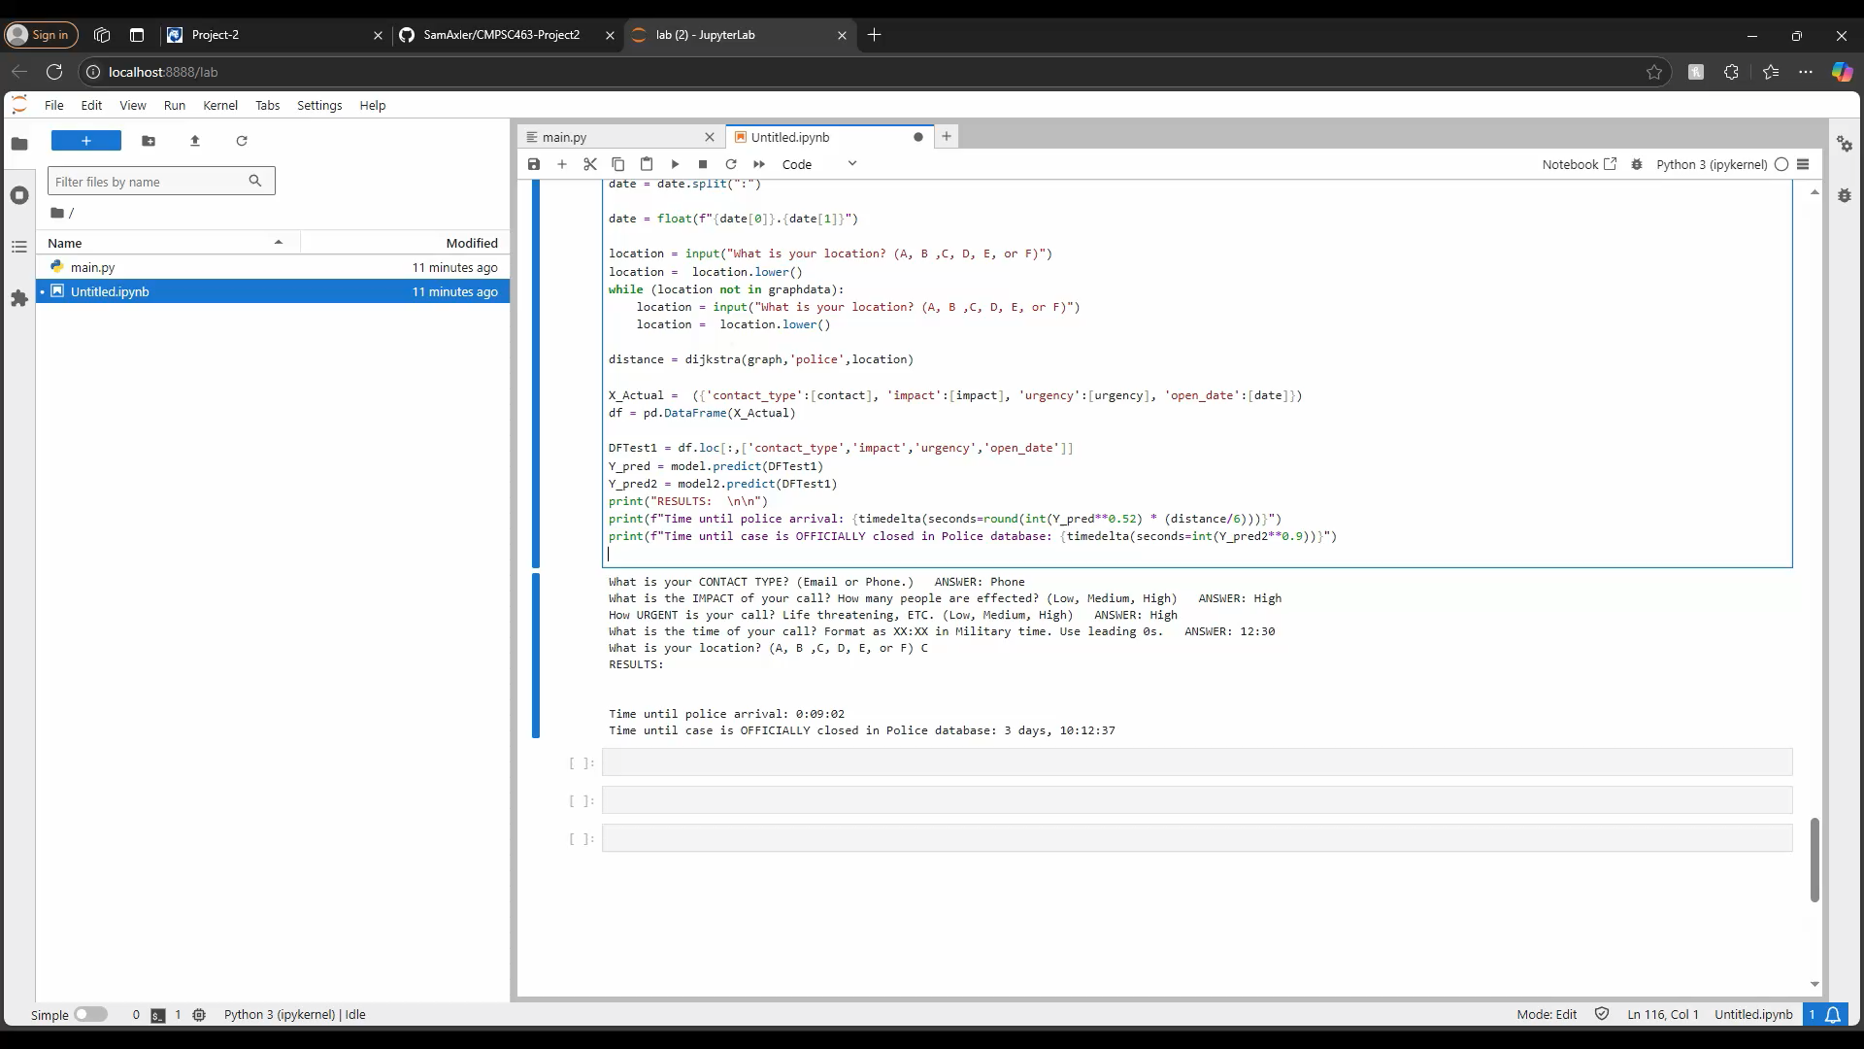
Example:

Slide 7
Potential Discrepancies and Improvements:
Arrival time inside Philadelphia may be different to the outskirts of Philadelphia.
While distance is considered, traffic and other conditions is not. Additionally, the distances used in the graph are purely hypothetical.
Potentially, the Linear Regression model could be over or underfit.
Most importantly, the type of crime is not included. Why?
Crime types are organized by categories, however, these categories are not consistent across different police departments. Including them would be misleading.

Slide 8
Conclusion
Police have several redacted methodologies for determining arrival timing. This makes it difficult to find a specific time without having insider information.
For a local estimator, this is as close as I can get without knowing this information.
Ultimately, I learned a lot about how the Police operate in an emergency from this project, and I hope you learned something as well.

